Slide 1
Research Computing Update
August 2020

Slide 2
HPC Resources
KU HPC Cluster
Continuing with re-registration process for all HPC users. This was to remove inactive accounts, as well as to collect project and PI information from users.
PR for support for h/w is still in process.
New HPC Procurement via ANKABUT
Still in process.

Slide 3
Training
“Research Computing intro session”, “Introduction to Linux”, and “Introduction to HPC” courses are all well attended and well received.
Training calendar is available at https://teamup.com/ksquu2jki56nesnr6n
Due to course being online, places are limited to 5 per session.
All three courses are delivered on a weekly basis.
Continuing to schedule three courses per week, and sending out invites at beginning of the month.
As number of attendees dimishing, have paused the regular scheduling of the courses, and only carrying on with the RC Intro session for new users as and when required.

Slide 4
Resource Utilization

Slide 5
KU Cluster core distribution

Slide 6
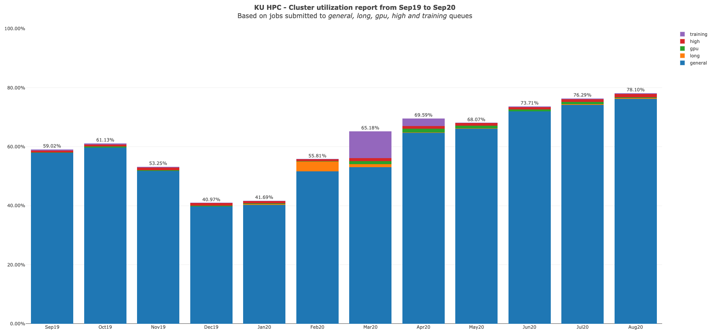

Slide 7
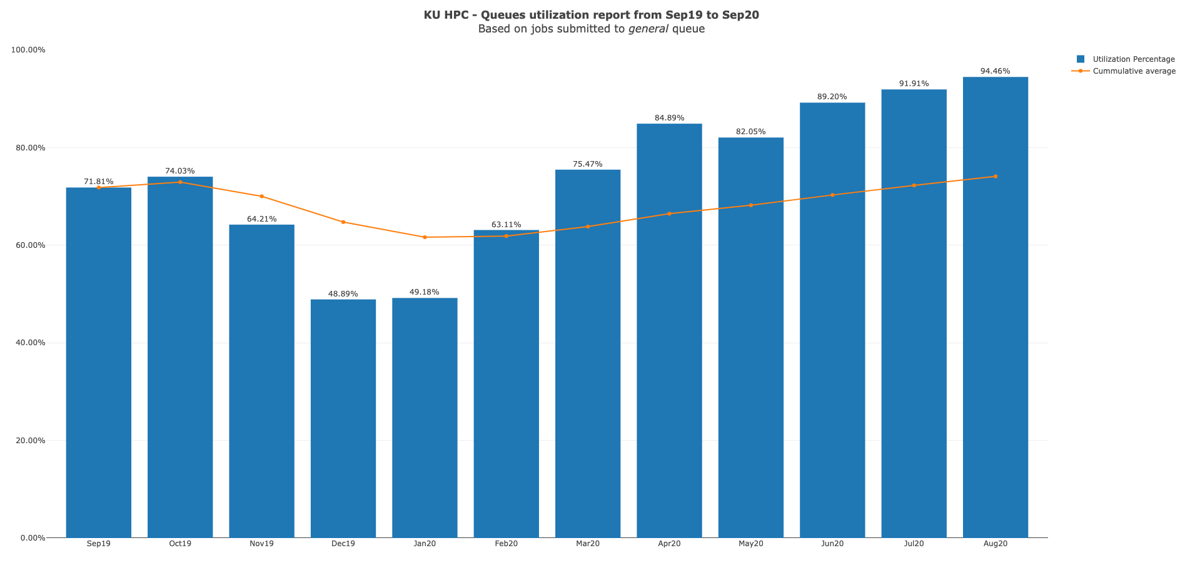

Slide 8
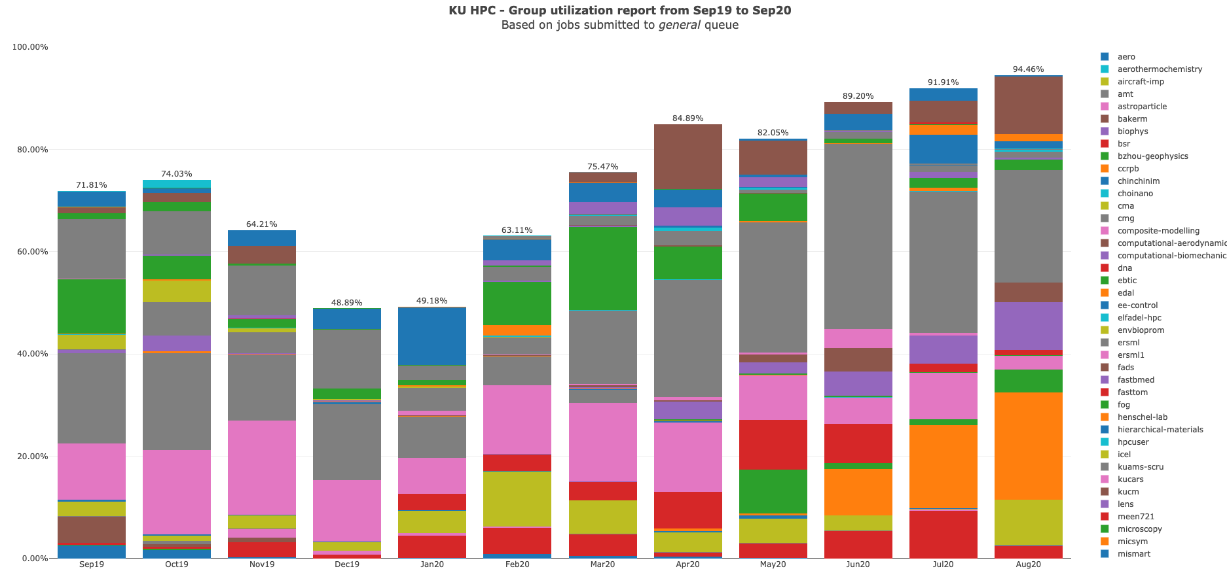

Slide 9
KU HPC Group Utilization for August 2020

Slide 10
PI Cluster core distribution

Slide 11
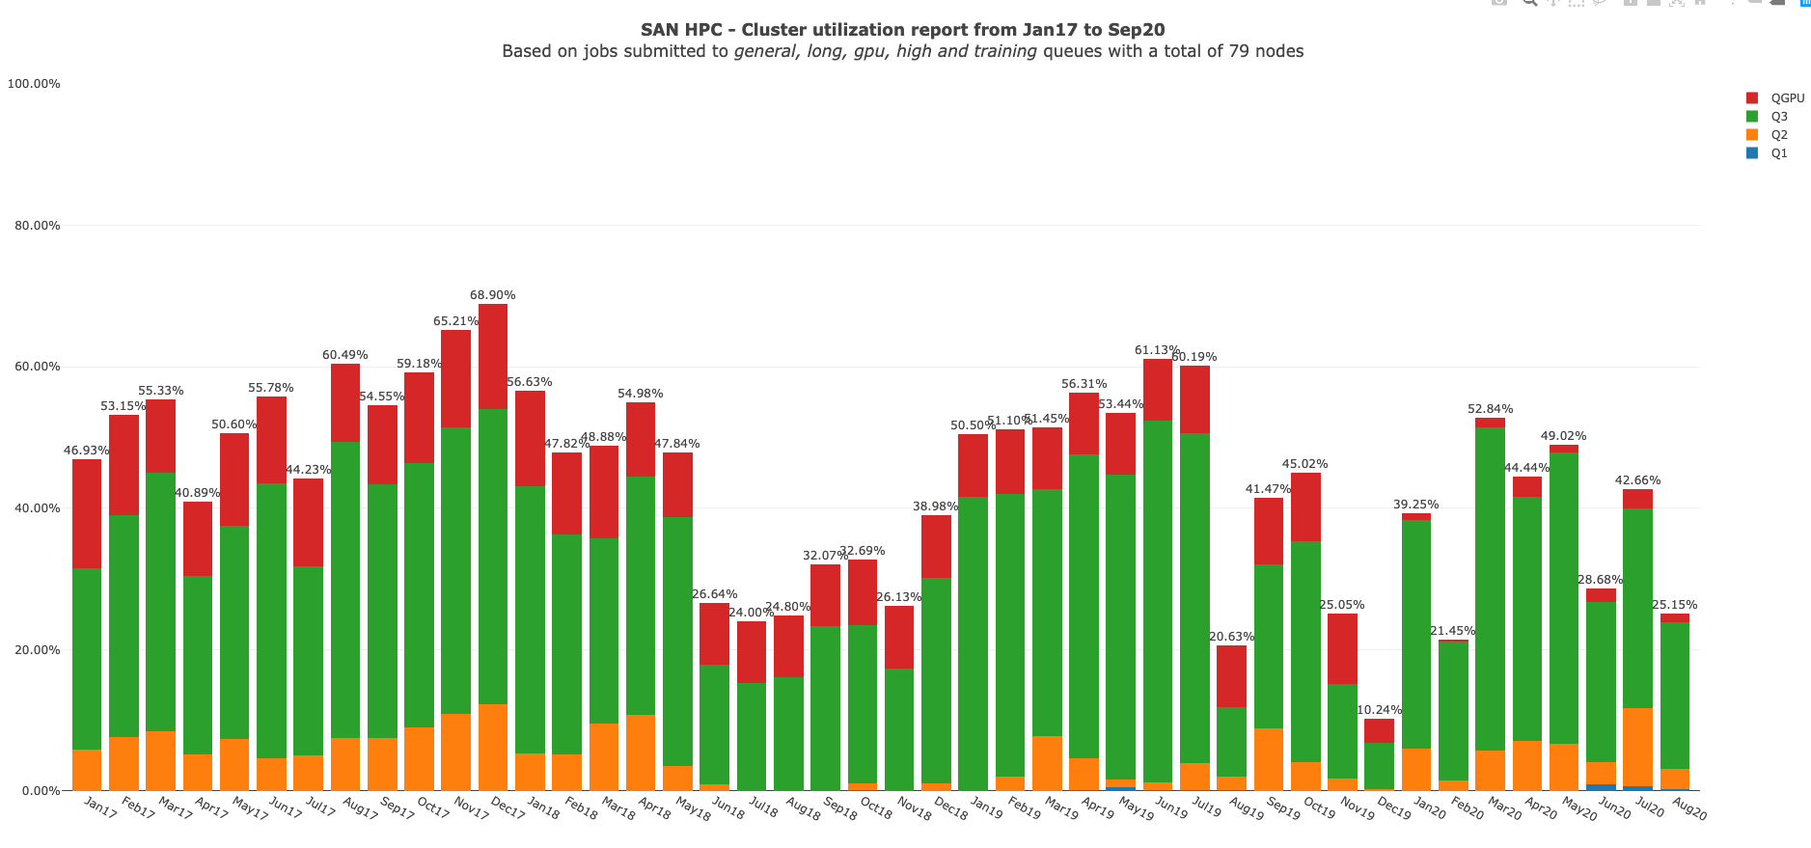

Slide 12
Status of KPI’s

